Slide 1
HOSTEL MANAGEMENT SYSTEM
By- Sanjeev Kumar(1801156)
Prince Kumar(1801131)
Rishu Raj(1801143)

Slide 2
Table of contents
Introduction
Problem Definition
Project Objective
Existing System
Proposed System
Software Requirements
Hardware Requirements
Module Description
Architecture
Screenshots
Testing example
Conclusion

Slide 3
INTRODUCTION
The main motive of our project is to manage various activities in the hostel.
The project deals with the problem of managing a hostel.
It avoids the problems that occurred manually, thereby reducing the warden’s workloads in the smooth running.
This project keep all the details of register students.
It also keeps details of all the various clubs and ongoing activities.
This project in the hostel can reduce all the problems faced in the current manual hostel management system.

Slide 4
PROBLEM DEFINITION
It is very demanding job which requires you to be on your toes 24*7.
The deadlines and checking up every facility to keep up with the demands of the students.
It requires constant learning and keeping yourself up to date with the latest tools and facilities in the market.
The work schedule is not fixed in such job profiles and requires you to be flexible in terms of timings.
Managing each each entry of complaint on notebook is taxing and takes lots of time and needs to manage multiple notebooks to deal with different kind of complaint.
Hostellers often not raise complaint and communicate with warden as they need to go specific place to fill the complaint on complaint notebook.

Slide 5
PROBLEM OBJECTIVE
The purpose of developing this software is to manage various activities in the hostel.
The project deals with the problem of managing a hostel.
It avoids the problems that occurred manually, thereby reducing the warden’s workloads in the smooth running.
Provide easier means of communication between students and warden.
Provide a platform to register various complaint easily by students.
Students can also apply for mess and hospital bill waiver.

Slide 6
EXISTING SYSTEM
To get mess bill compensation, all the students have to go for various paperwork which takes lots of time.
Emergency medical facilities are always an issue.
Schedule of room cleaning and class lecture coincides, thus making the room uncleaned.
Mess complain issue
Any suggestion by students has to go through various people before reaching facility members.

Slide 7
PROPOSED SYSTEM
Student Registration: Administrator can register a student
Login System: Users and administrator have to log in using webmail only.
Waiver: Student can apply for mess and hospital bill waiver.
Mess bill: Student check their mess bill.
Medical: Contains necessary information regarding a medical emergency, services and medicines
News: Administrator
Complain Management: Lodge a complaint regarding cleaning, mess food etc.

Slide 8
SOFTWARE REQUIREMENTS
Scripting Language: HTML, CSS, Bootstrap, JavaScript
Frontend Framework: React.js
Database: MongoDB
Backend: Node.js

Slide 9
HARDWARE REQUIREMENTS
Processor: Intel Core i5
Ram: Minimum 4GB
Hard Disk: 500GB +

Slide 10
MODULE DESCRIPTION
Administrator module:
In administrator module, administrator manages the master datas like server details and student details. Accept the application of the students, view the application forms, reject the fake applications, view the complaints in the hostel, accept the fee and medical waiver application and update mess fees.
Student Module:
In student module, they can request for room cleaning, food quality complaint,apply for waiver, can view monthly mess fees and provide any suggestion needed.

Slide 11
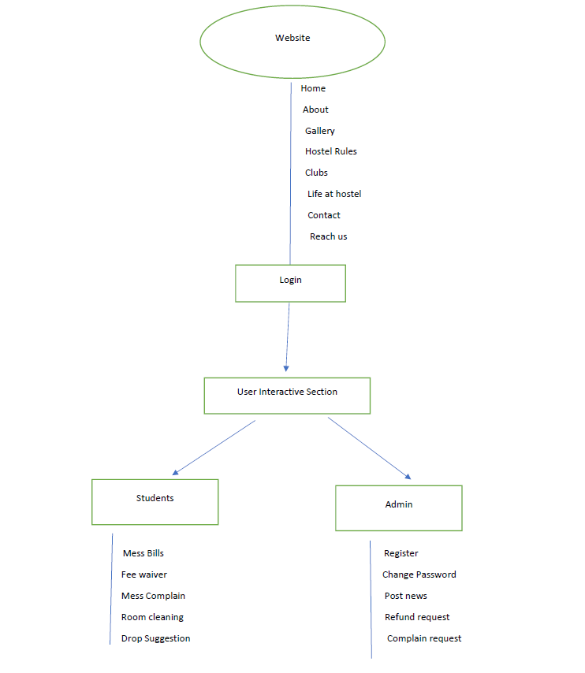
ARCHITECTURE

Slide 12
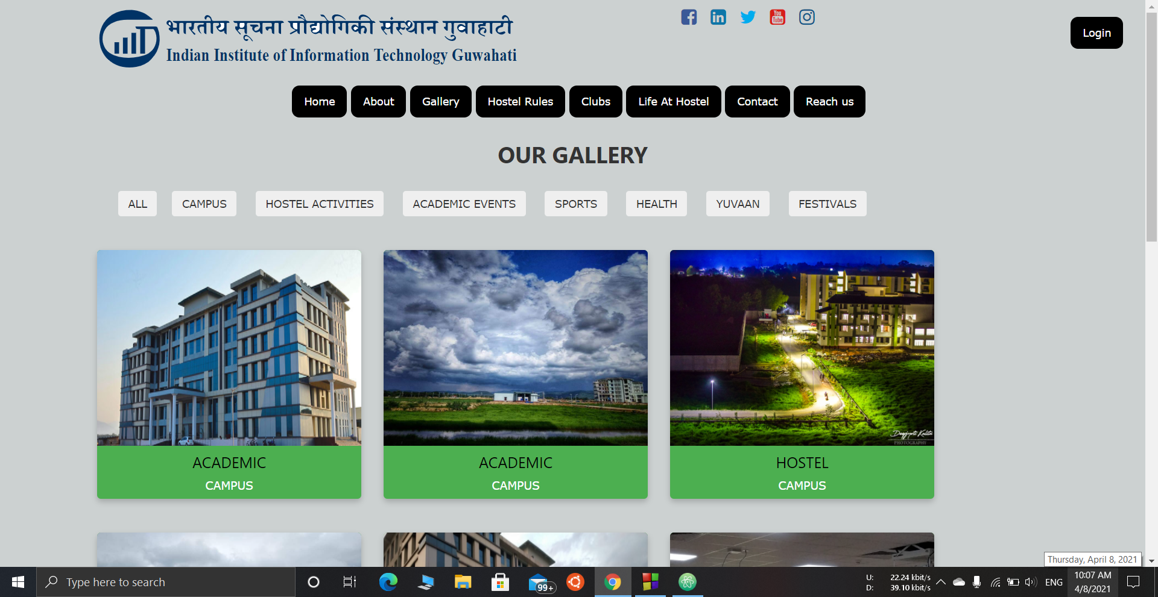
SOME SCREENSHOTS

Slide 13
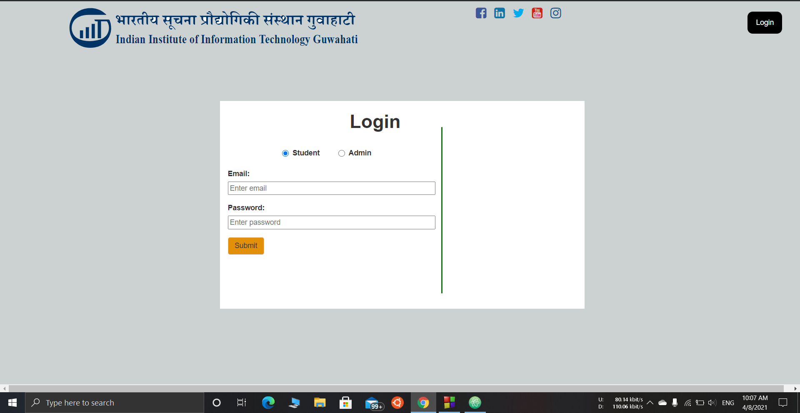
SCREENSHOTS(Login Details window)

Slide 14
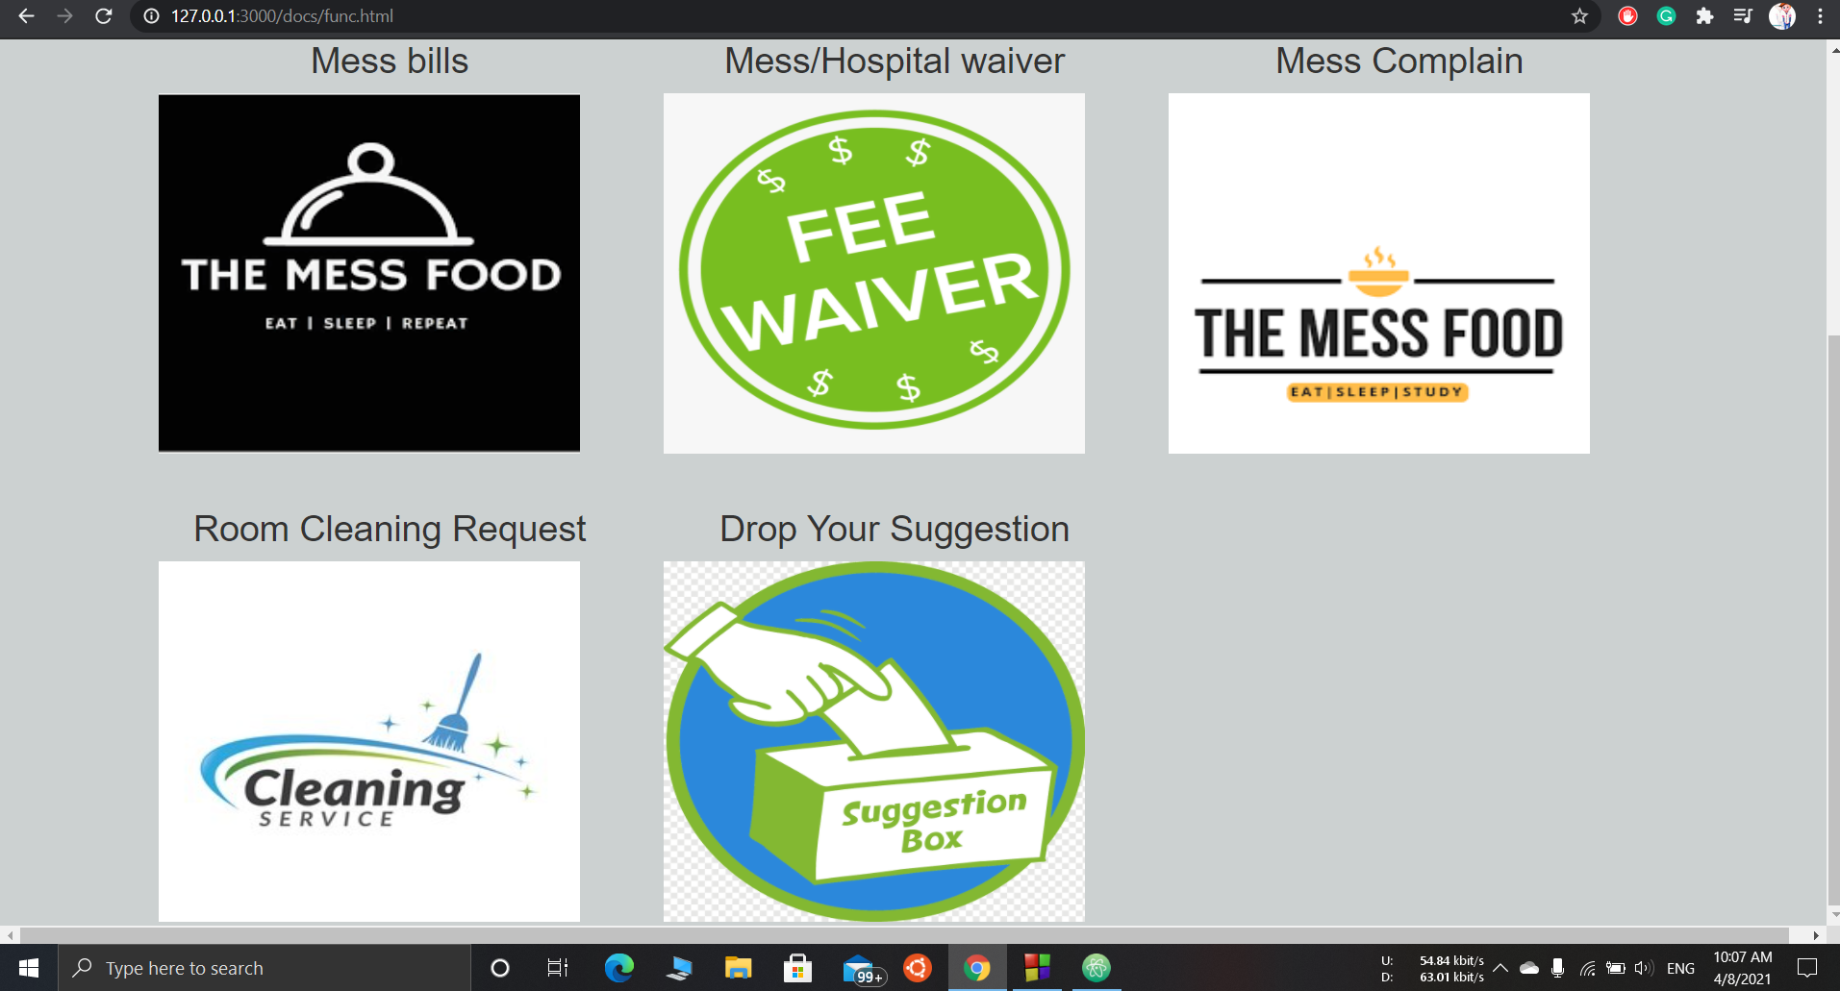
SCREENSHOTS(function req)

Slide 15
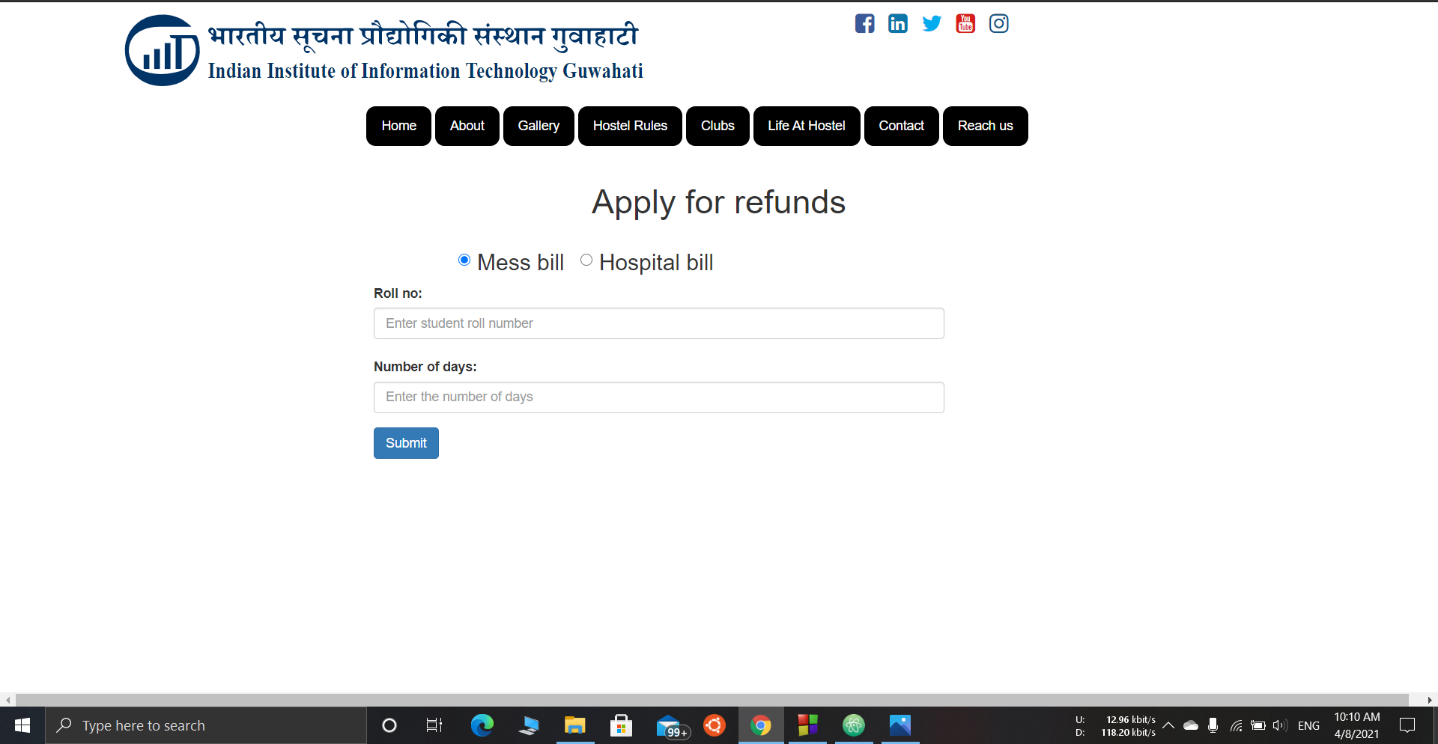
SCREENSHOTS (Functional req)

Slide 16
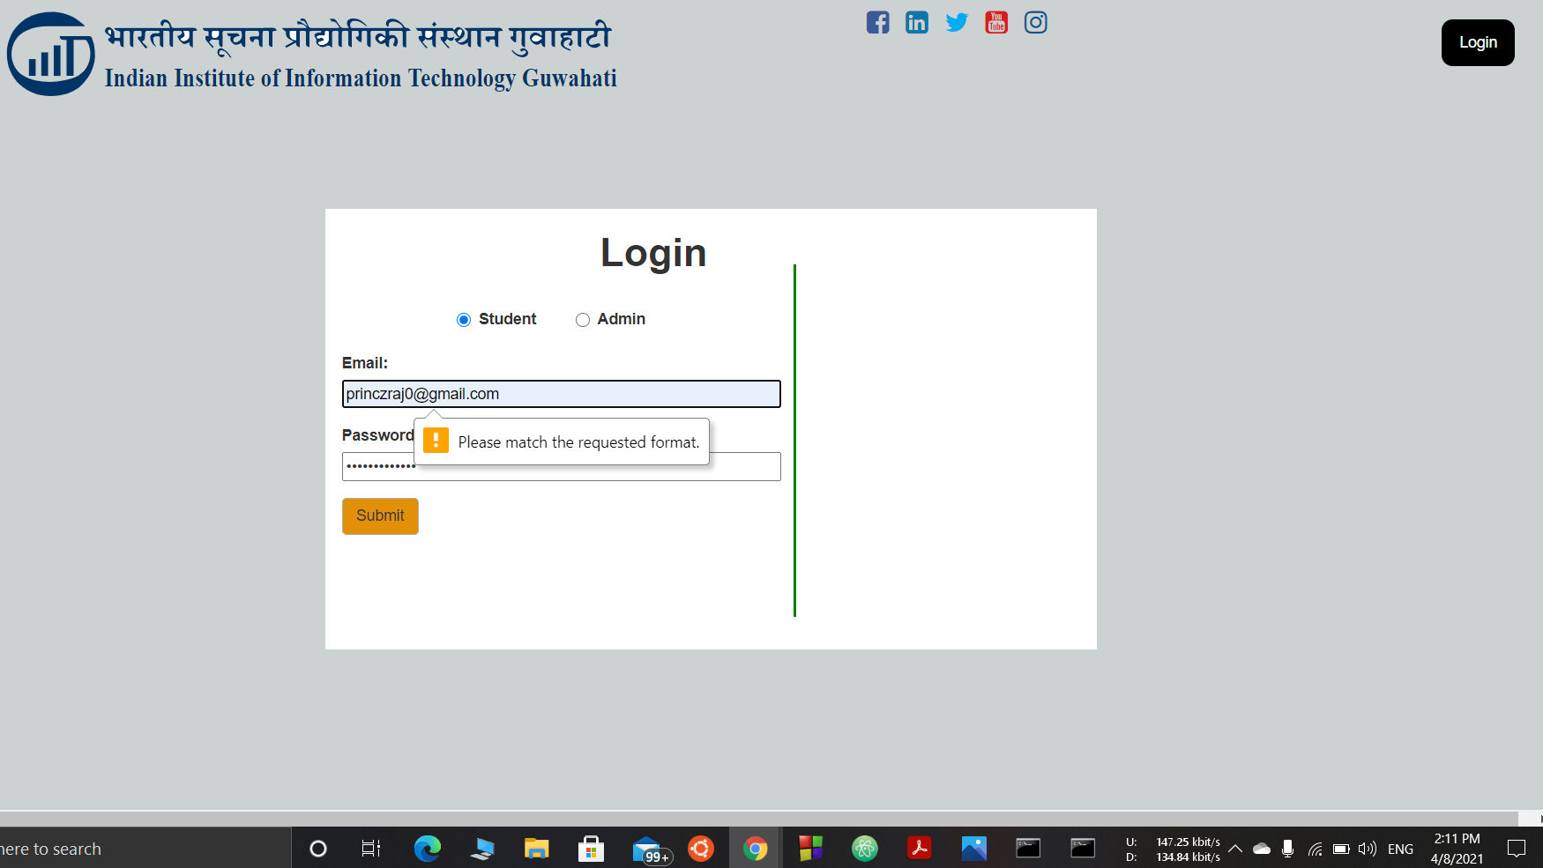
TESTING
This is one of the example of testing on the login page where other than using webmail no one can login in this website.

Slide 17
CONCLUSION
HOSTEL MANAGEMENT SYSTEM is very useful for complaint management and mess fee calculation. This hostel management software is designed for people who will manage various activities in the hostel. The number of hostel in the campus will increase in the future for the accommodation of students studying in the institute.And hence there is and will be a lot of strain on the person who is running the hostel and any software is not used in this context. This particular project deals with the problems on managing a hostel and avoids the problems which occur when carried manually.
Identification of the drawbacks of the existing system leads to the designing of computerised system which is more user friendly and more GUI oriented.

Slide 18
THANK YOU!

